Slide 1
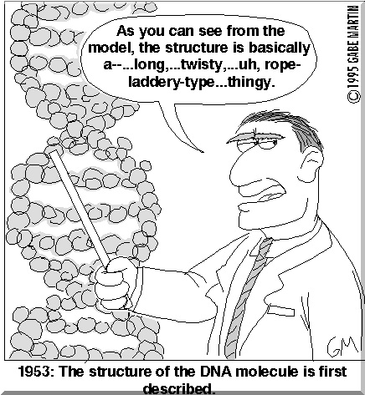
BB2950 Day 2: Thursday 10-26-17
Learning objectives:
Clarify the differences between prokaryotes and eukaryotes.
Review the basics of the genetic code.
Explain why mutations can lead to phenotypic changes, and what dictates the effects a particular mutation will have.
Diagram the primary structure of DNA and RNA, including key features of the constituent nucleotides, the bonds that connect them, and the 5’ and 3’ ends.
List the bases found in DNA and RNA.
Describe the two major chemical differences between DNA and RNA, and the effect these differences have on structure and function.

Slide 2
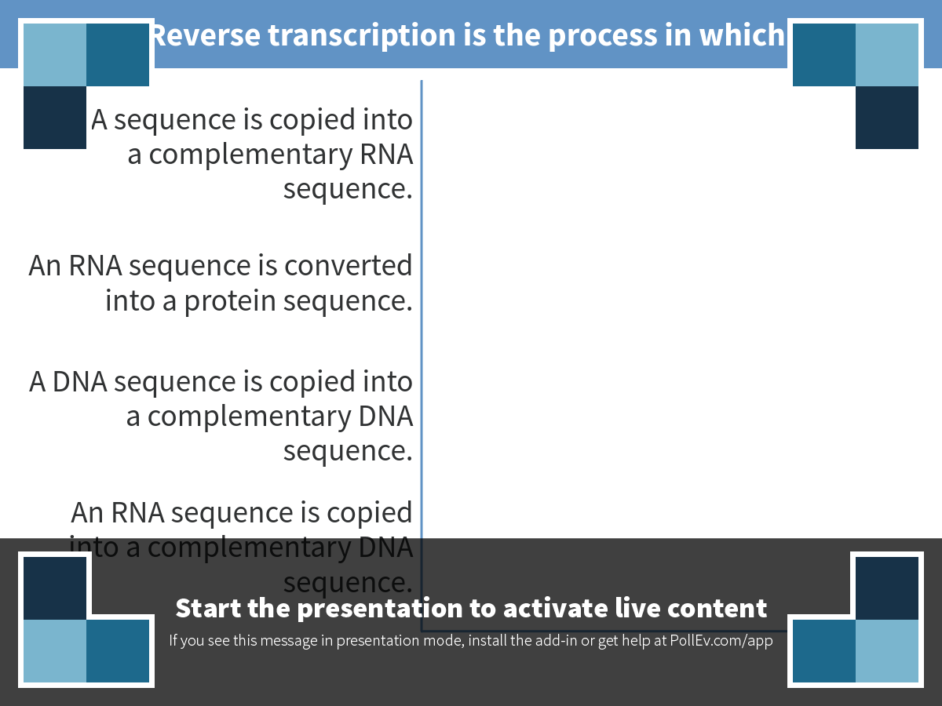
Notes:
Poll Title: Reverse transcription is the process in which: https://www.polleverywhere.com/multiple_choice_polls/Lqv99b3AY1J9C77

Slide 3
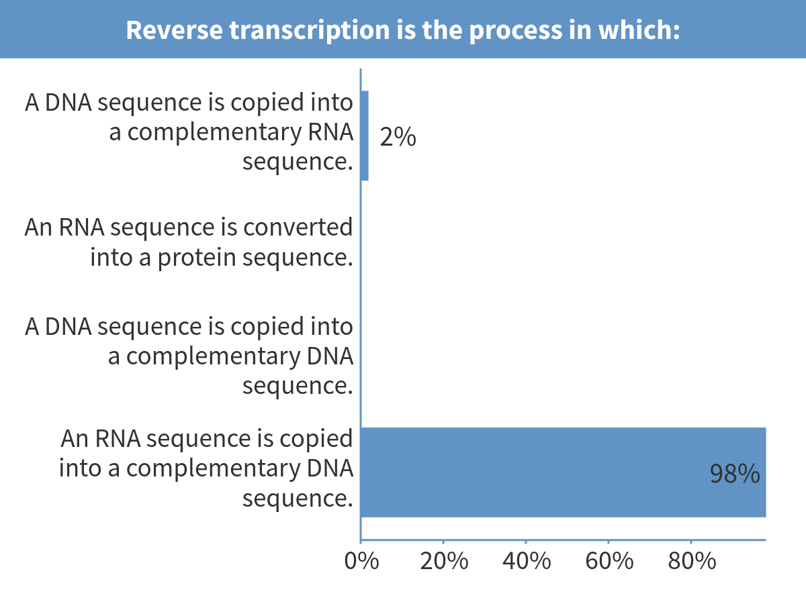
Notes:
Reverse transcription is the process in which:

Slide 4
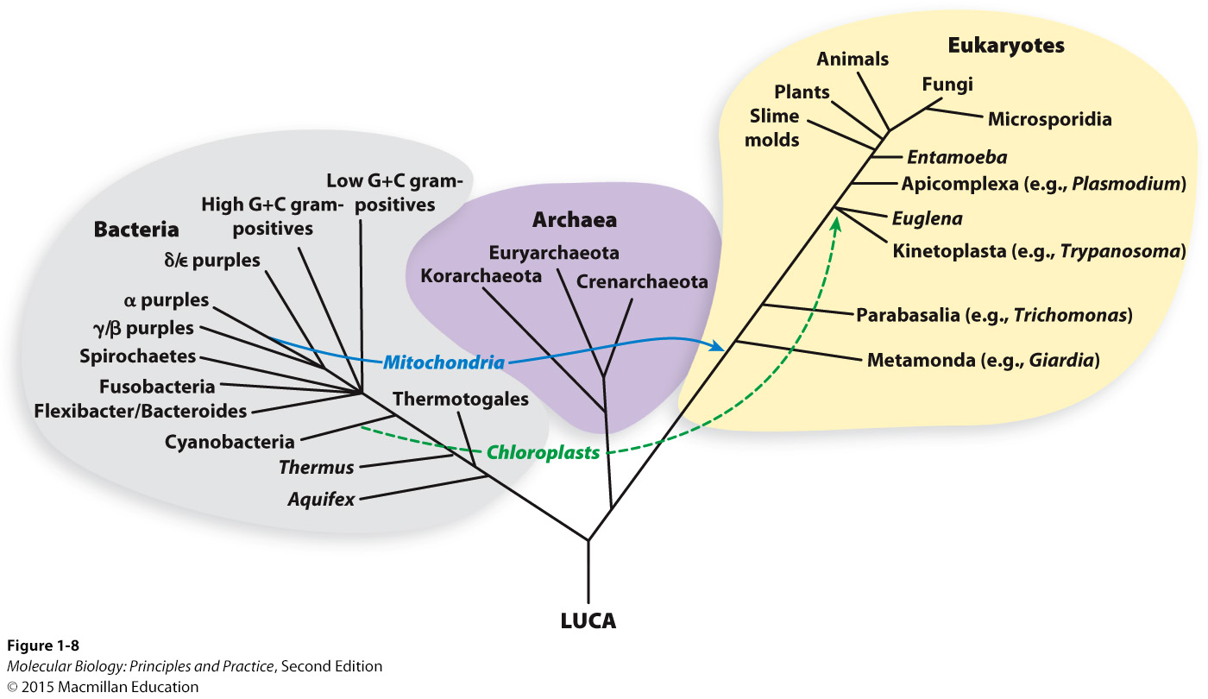
Prokaryotes
Usually unicellular (single-celled)
Usually lack membrane-bound organelles
No nucleus
Usually have cells walls
Often have a single, circular chromosome
Different gene and genome structures
Eukaryotes
Can be unicellular (yeast, amoebas, others) or multicellular (plants, animals)
Always have various membrane-bound organelles
DNA is enclosed in the nucleus
May have cell walls (plants, fungi)
Usually have multiple linear chromosomes

Slide 5
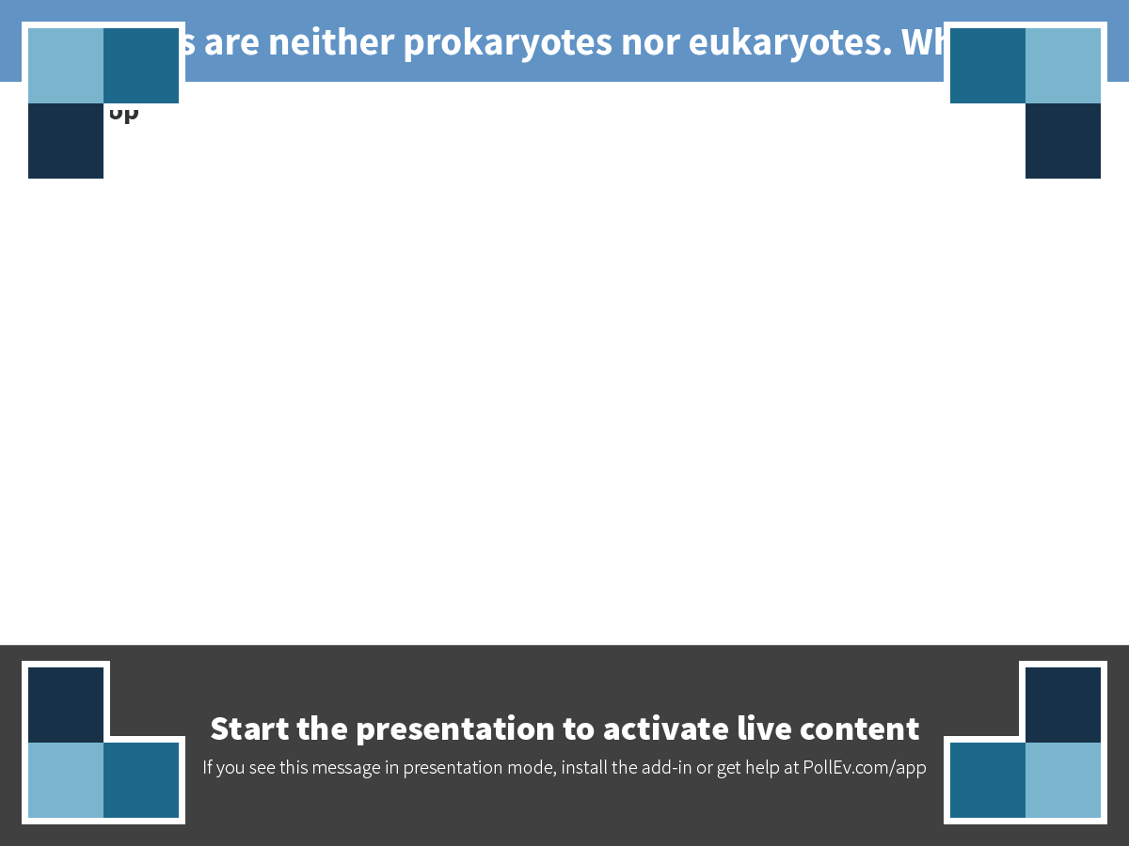
Notes:
Viruses are neither prokaryotes nor eukaryotes. Why not?
https://www.polleverywhere.com/discourses/vG1jENoAz1FskLV

Slide 6
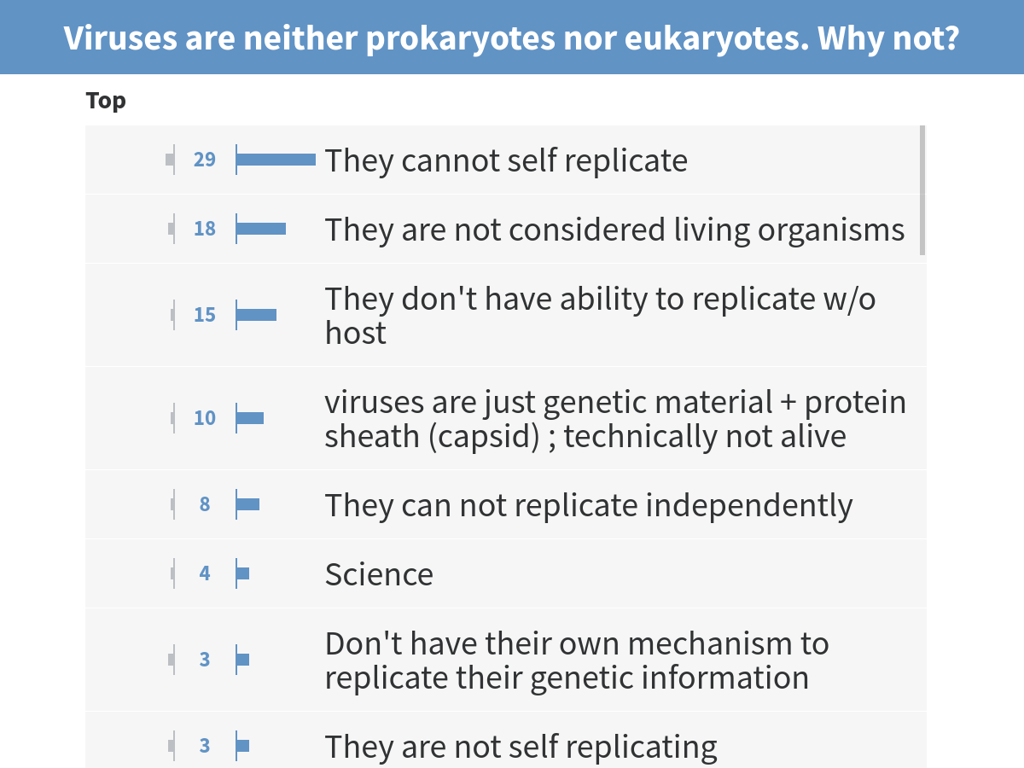
And they are not cells. Unlike cells, they lose their corporal integrity as part of their life cycle
Prof. Shell votes for this one:
Notes:
Viruses are neither prokaryotes nor eukaryotes. Why not?

Slide 7
Let’s get comfortable with the genetic code.
How many 3-letter words can you spell using a 4-letter alphabet?

Slide 8
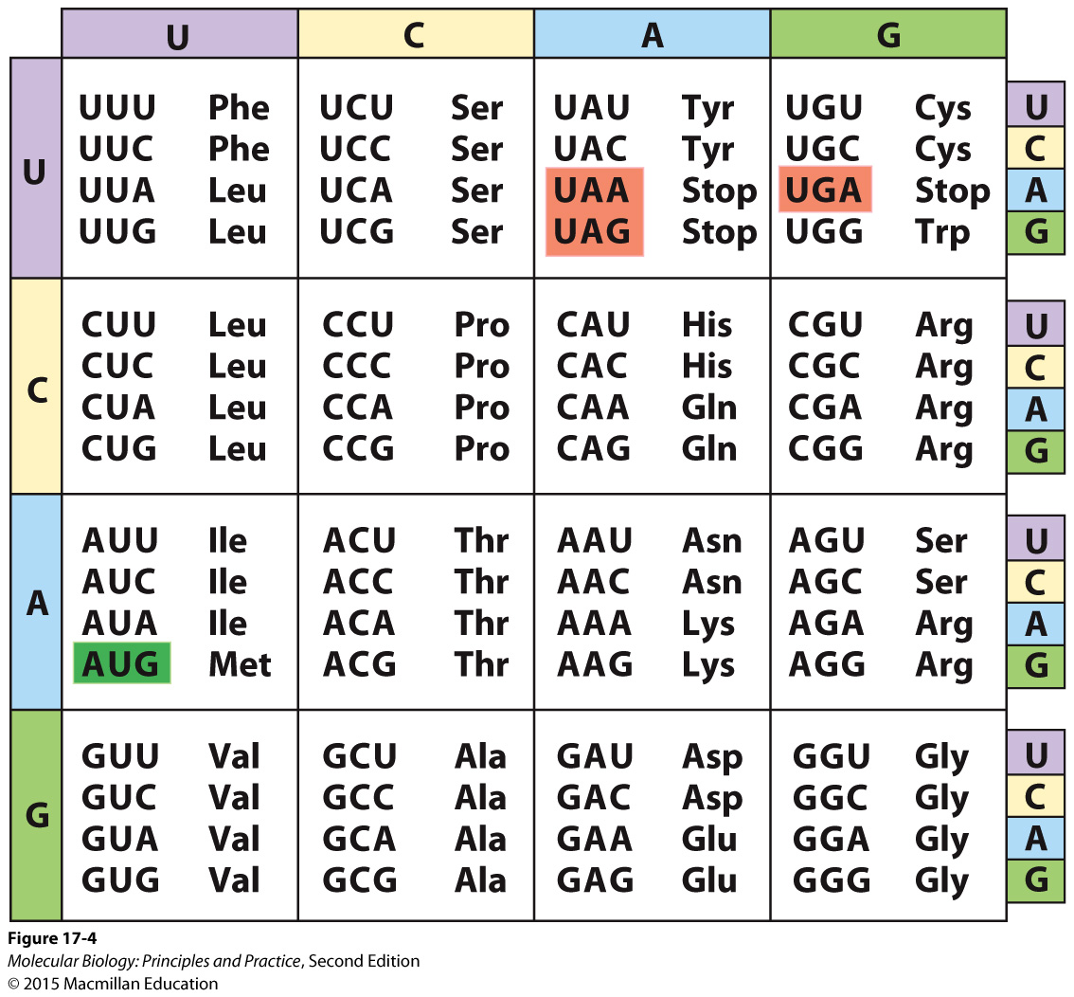
What amino acid sequence is encoded by this DNA sequence? Work with your neighbor! Be sure to ask your neighbor’s name!
CTGACTCCTGAGGAGAAGTCT

Slide 9
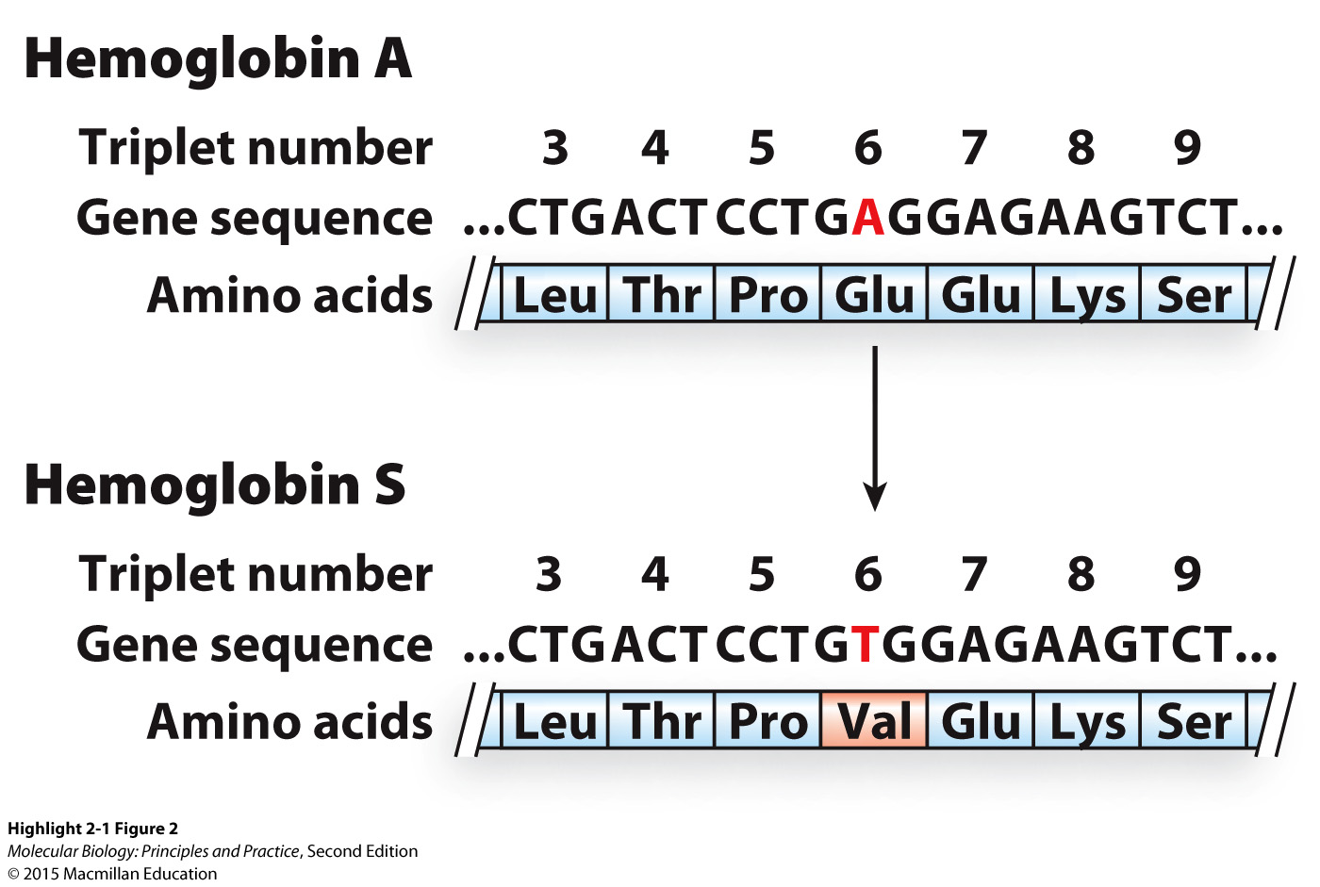
When a mutation changes the amino acid sequence of a protein, it may cause a change in phenotype

Slide 10
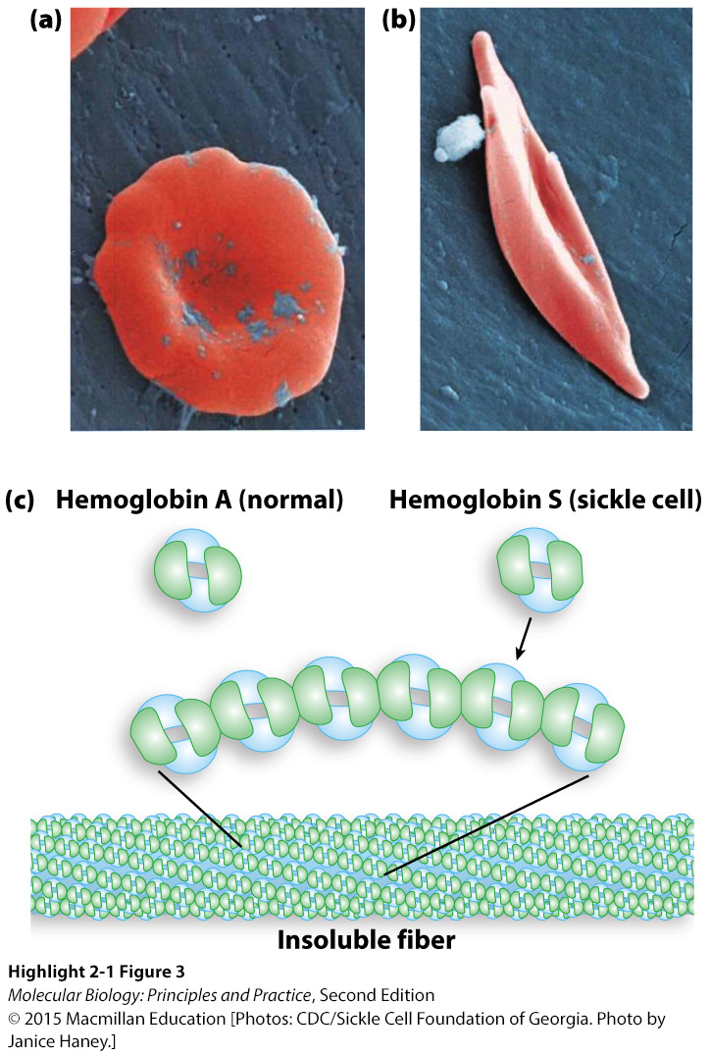
In the case of sickle cell anemia, a single amino acid change has a drastic effect on protein function

Slide 11
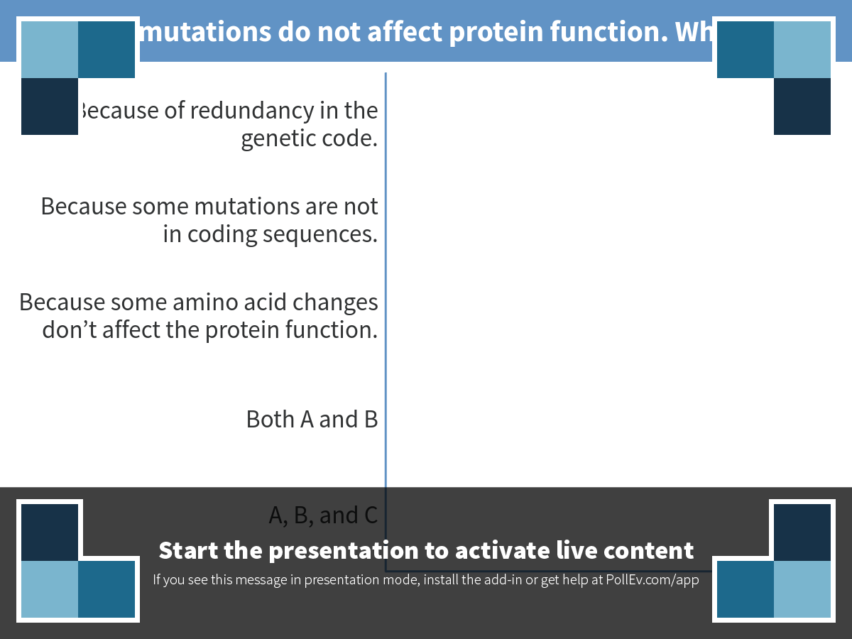
Notes:
Poll Title: Some mutations do not affect protein function. Why not? https://www.polleverywhere.com/multiple_choice_polls/zGGFP5i2F3fIAhG

Slide 12
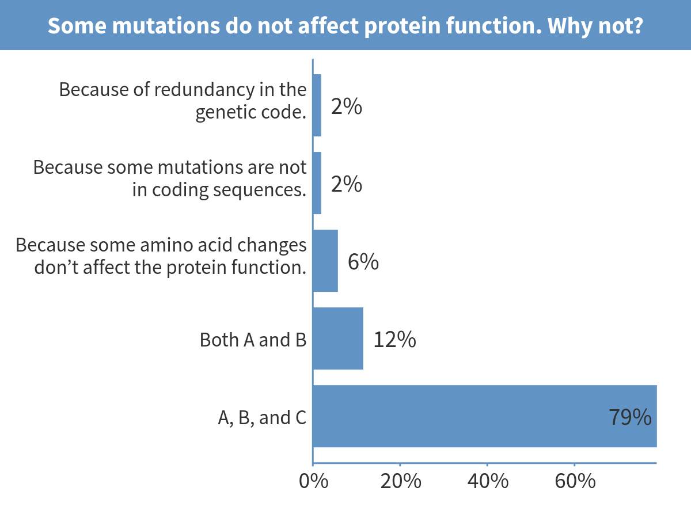
Notes:
Some mutations do not affect protein function. Why not?

Slide 13
What would happen if a nt is deleted from the gene sequence?

Slide 14
What would happen if a nt is deleted from the gene sequence?
What effect will this have on function?

Slide 15
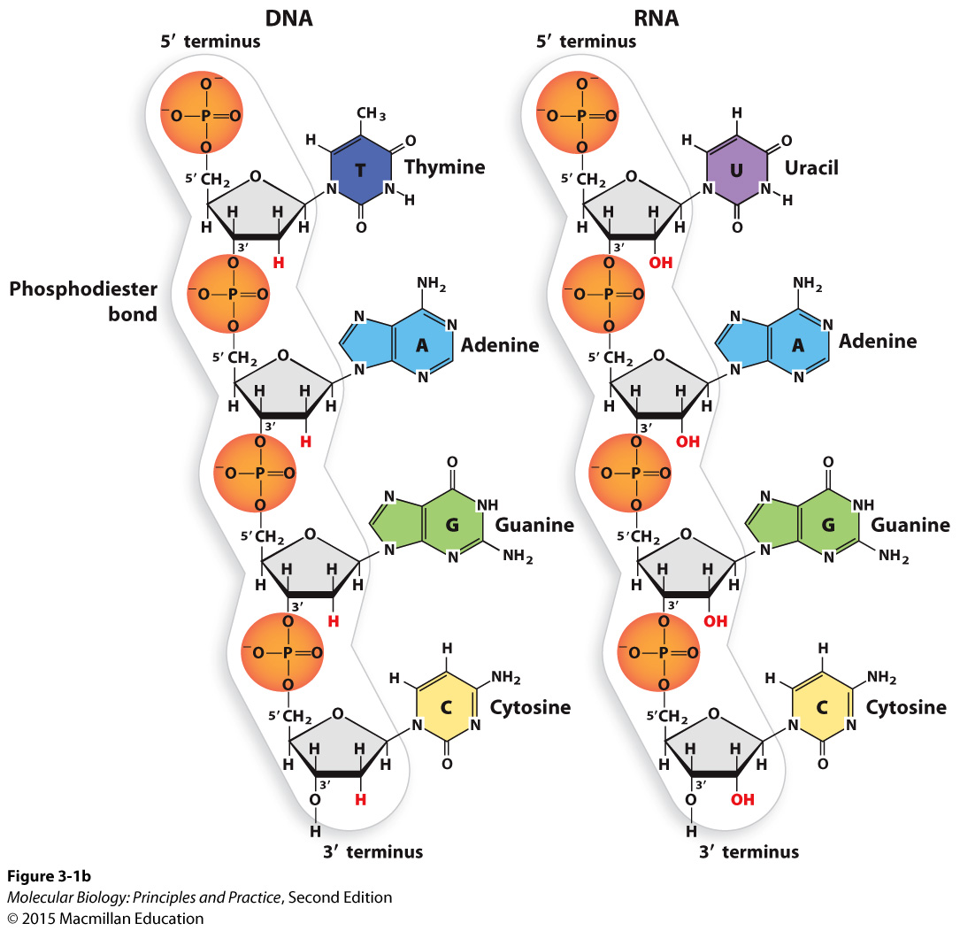
The nucleic acids

Slide 16
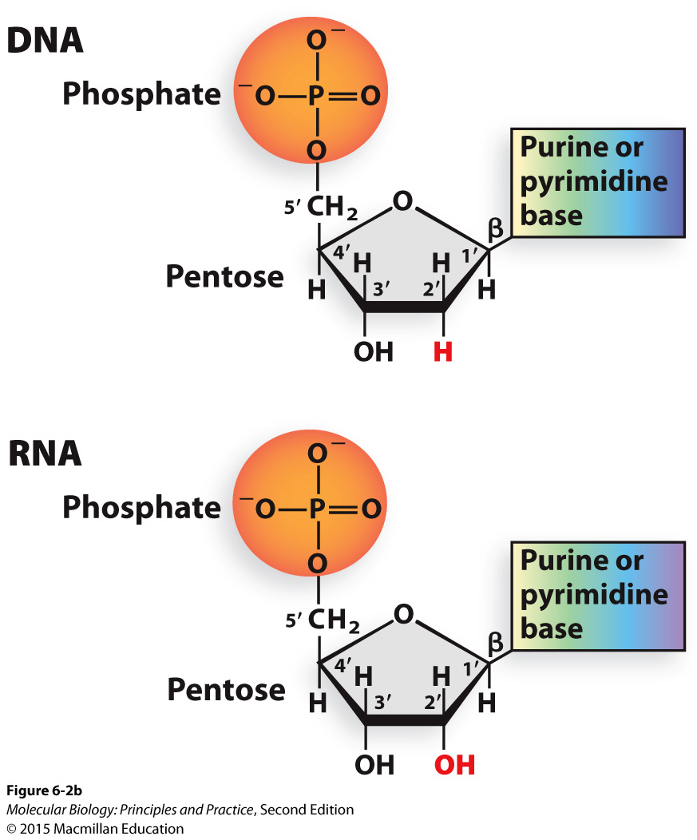
The presence or absence of a 2’ hydroxyl group distinguishes RNA from DNA

Slide 17
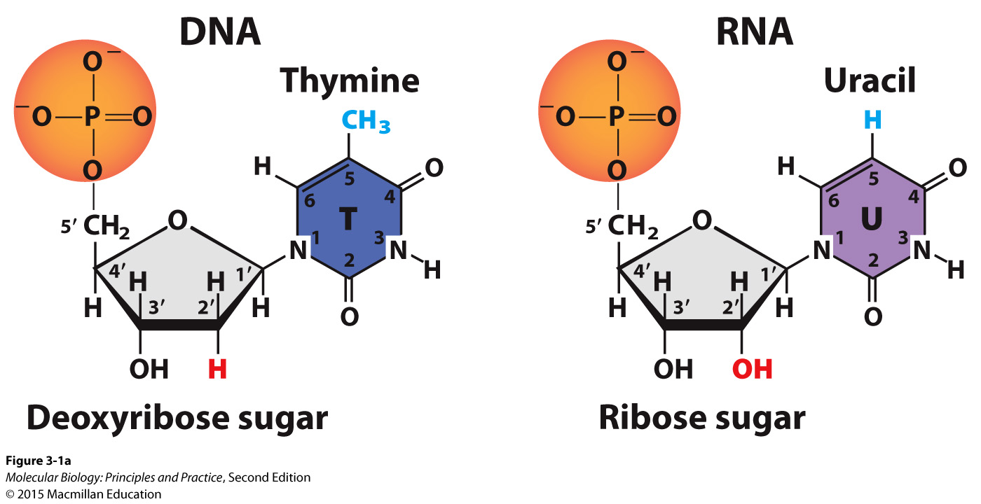
Thymine is replaced with uracil in RNA

Slide 18
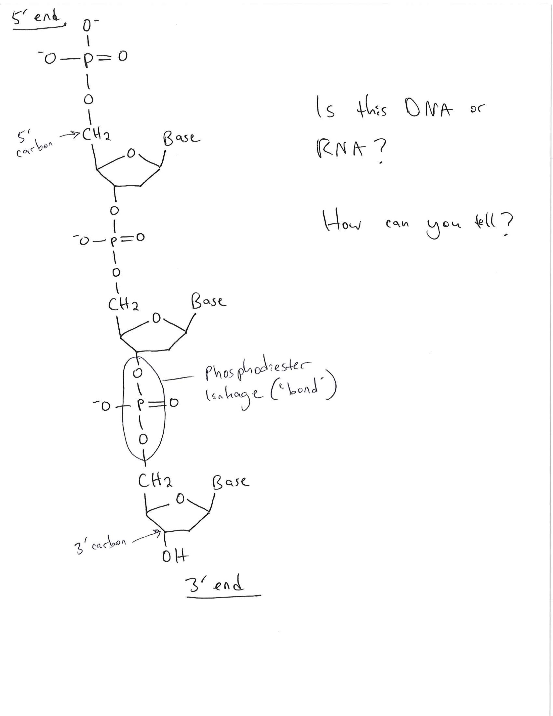
The level of structural detail you need to be able to draw for this course:

Slide 19
The importance of nucleic acid polarity (5’ and 3’ ends)
5’-TAGC-3’ is a different molecule than 3’-TAGC-5’
The convention is to write nucleic acid sequences from 5’ to 3’. If not specified otherwise, assume a nucleic acid sequence is 5’ to 3’. Therefore:
TAGC = 5’-TAGC-3’

